Slide 1

Application of Rotation Matrix in 3D Movie
Department of Engineering & Applied Science
Roll No. | PRN | Name of student | Div. | VIIT email ID
1412 | 22110206 | Prasad Nathe | N | prasad.22110206@viit.ac.in
1414 | 22110268 | Rutuja Jadhav | N | rutuja.22110268@viit.ac.in
1418 | 22110305 | Sahil Savardekar | N | sahil.22110350@viit.ac.in
1421 | 22110398 | Siddhesh Khairnar | N | siddhesh.22110398@viit.ac.in
BRACT’S, Vishwakarma Institute of Information Technology, Pune-48
(An Autonomous Institute affiliated to Savitribai Phule Pune University)
(NBA and NAAC accredited, ISO 9001:2015 certified)

Slide 2


INDEX
Rotating Points Using RM(2D)
Concept Used – Rotational Matrix
Rotational Matrix Concept in 3D
Example Of Rotation Matrix
Main Components Of Rotation Of matrix
Summarizing The Concepts
Prasad Nathe, Department of Engineering and Applied Sciences, VIIT, Pune-48

Slide 3

What is Rotation Matrix
A rotation matrix can be defined as a transformation matrix that operates on a vector and produces a rotated vector such that the coordinate axes always remain fixed.
A rotation matrix is always a square matrix with real entities.
Rotation matrices provide an algebraic description of such rotations, and are used extensively for computations in geometry, physics, and computer graphics.
Prasad Nathe, Department of Engineering and Applied Sciences, VIIT, Pune-48

Slide 4
Rotating Points Using RM(2D)
x1 = x0 cosΦ – y0 sin Φ
y1 = y0 cos Φ + x0 sin Φ
x1
y1
CosΦ -sinΦ
sin Φ cosΦ
x0
y0
=
(x1,y1)
(x0,y0)
R
Φ
y0= r sinΘ
Θ
x0 = r cos Θ
Prasad Nathe, Department of Engineering and Applied Sciences, VIIT, Pune-48

Slide 5
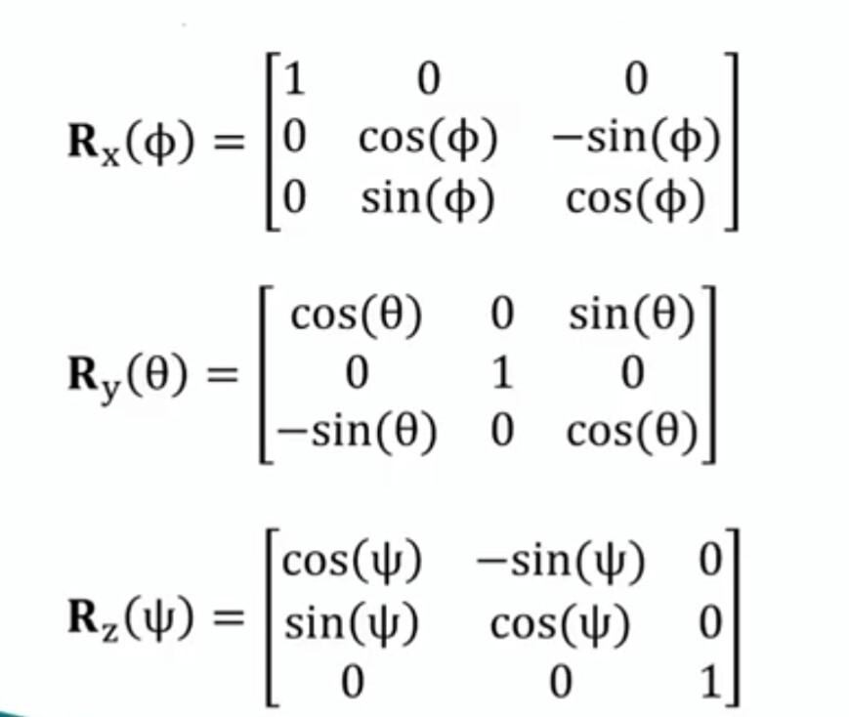
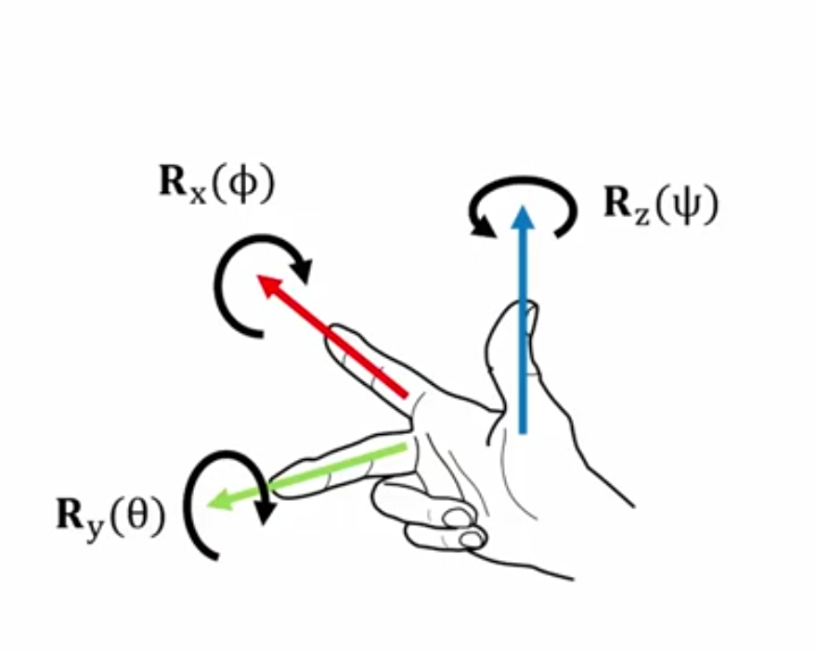
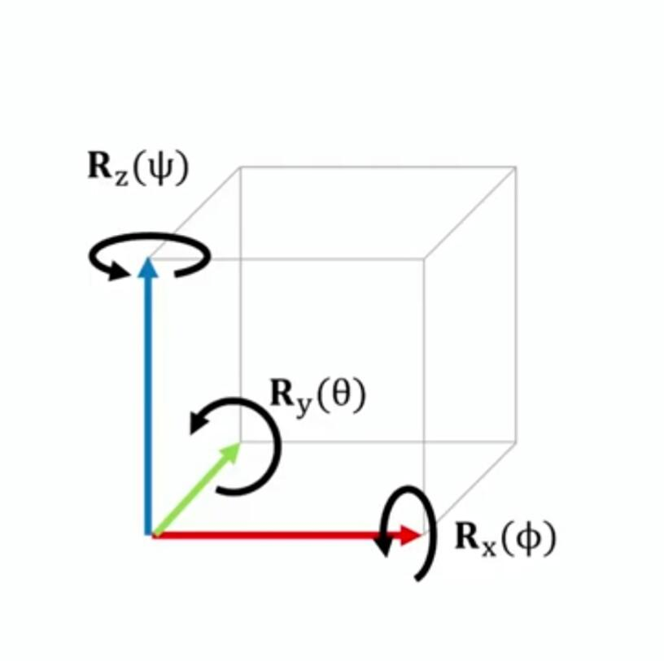
Concept Used-Rotational matrix
Rotation matrix is used in 3D movie to rotate objects and action figure this has improved the 3D industries and become a key part of 3D production it also reduced the time of production to explain it we can take help of right hand rule ( as given below). Each column is a 3D unit vector• x,y,z∈R^3•llxll=lyll=llzll=1. and also all columns are orthonormal
Right Hand Rule
x-axis forward, from the index finger
y-axis left, from the middle finger
z-axis up, from the thumb
Roll Φ about x-axis
pitch θ about y-axis
Yaw ψ about z axis
Prasad nathe, Department of Engineering and Applied Sciences, VIIT, Pune-48

Slide 6
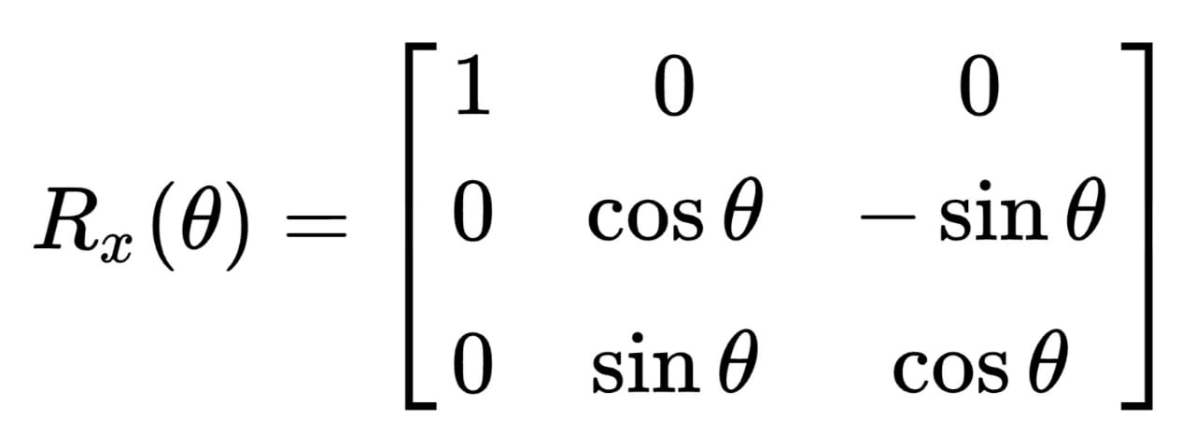
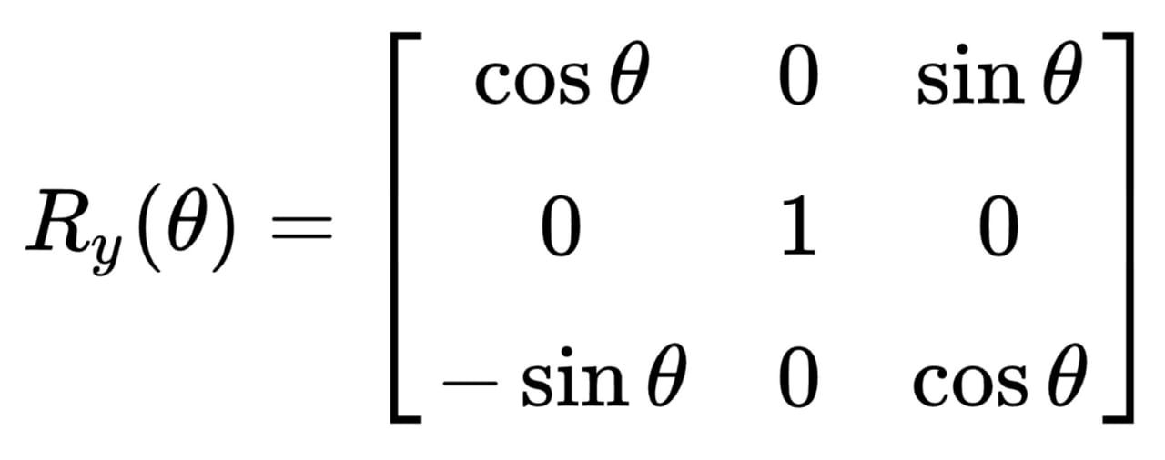
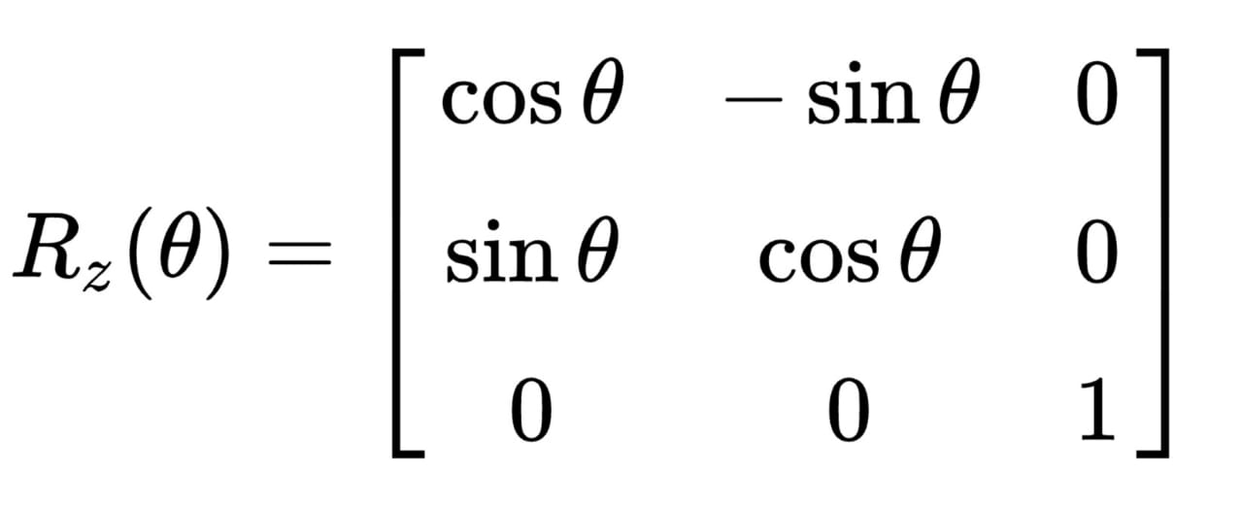
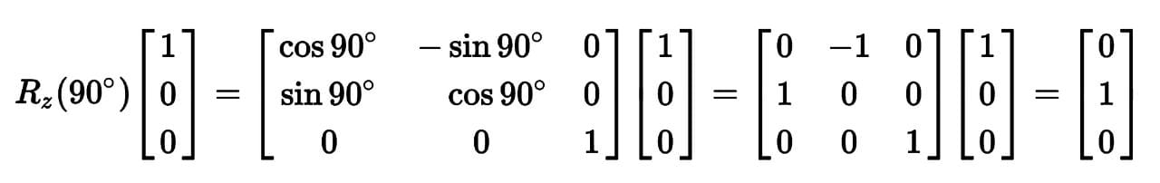
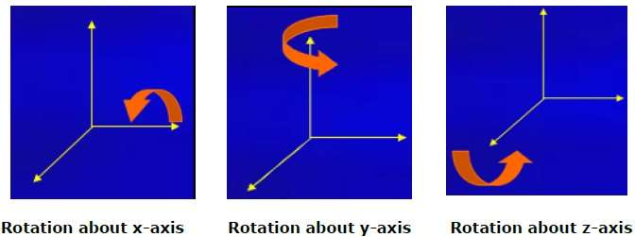
ROTATION MATRIX CONCEPT IN 3D
Basic rotations:- A basic rotation is a rotation about one of the axes of a coordinate system. The following three basic rotation matrices rotate vectors by an angle θ about the x-, y-, or z-axis, in three dimensions, using the right-hand rule —which codifies their alternating signs.
For colum vector, each of these basic vector rotations appears counterclockwise when the axis about which they occur points toward the observer, the coordinate system is right-handed, and the angle θ is positive. R_{z}, for instance, would rotate toward the y-axis a vector aligned with the x-axis, as can easily be checked by operating with R_{z} on the vector (1,0,0):
Sahil Savardekar, Department of Engineering and Applied Sciences, VIIT, Pune-48

Slide 7

EXAMPLE OF ROTATION MATRIX
The 3 × 3 rotation matrix
1]
corresponds to a −30° rotation around the x-axis in three-dimensional space.
Sahil Savardekar, Department of Engineering and Applied Sciences, VIIT, Pune-48

Slide 8
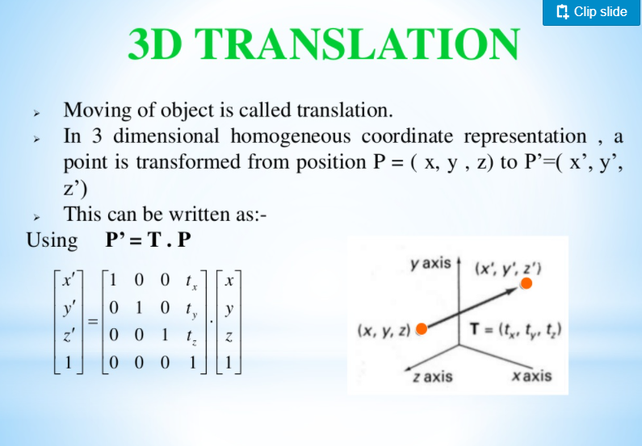
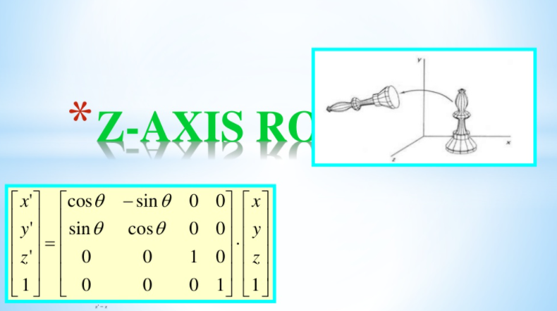
Main components of use of Rotation Matrix
1. Translation
Moving of object is called translation. In 3D Homogenous co-ordinate representation, a point is transferred from position P= (x ,y ,z ) to P’=(x’ , y’ , z’). This can be written as P’ = T.P
= [x + txy + tyz + tz1]
P’ = T . P
2. Rotation
When an object is to be rotated about an axis that is parallel to one of the co-ordinate axis, we can obtain the desired rotation with the following transformation sequence;
Z-axis Rotation (Roll)
Equation for z-axis rotation
x’ = xcosθ - ysinθ
y’ = ysinθ + zcosθ
z’ = z
Siddhesh Khairnar, Department of Engineering and Applied Sciences, VIIT, Pune-48

Slide 9
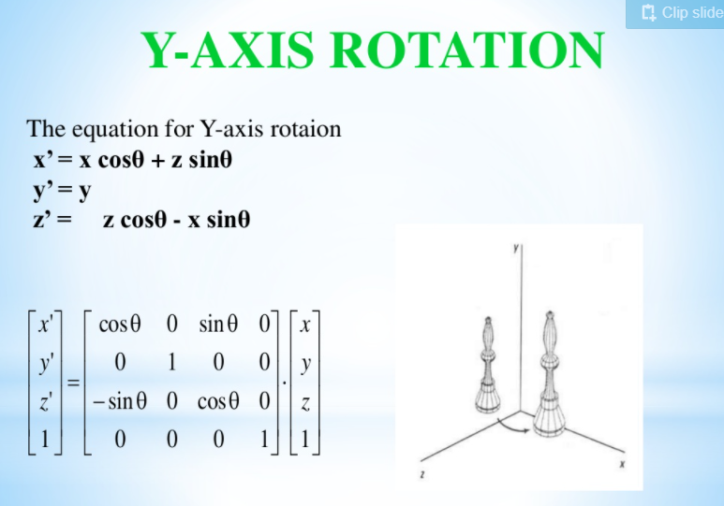
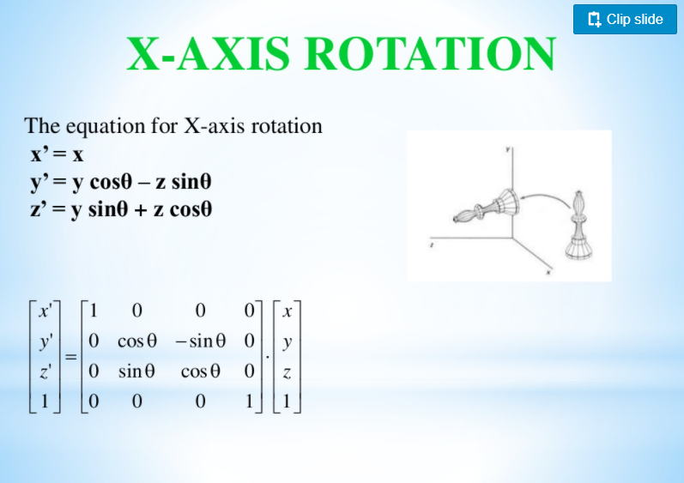
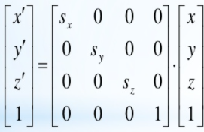
Y-axis Rotation (Yaw)
Equation for y-axis rotation
x’ = xcosθ + zsinθ
y’ = y
z’ = zcosθ – xsinθ
X-axis Rotation (Pitch)
Equation for x-axis rotation
x’ = x
y’ = ycosθ - zsinθ
z’ = ysinθ + zcos θ
3. Scaling
Changing the size of the object and repositions of the object relative to the co-ordinate sign.
x’ = x . sx
=> y’ = y . sy
z’ = z . sz
Siddhesh Khairnar, Department of Engineering and Applied Sciences, VIIT, Pune-48
Mr. Gajanan Ghuge, Department of Engineering and Applied Sciences, VIIT, Pune-48

Slide 10
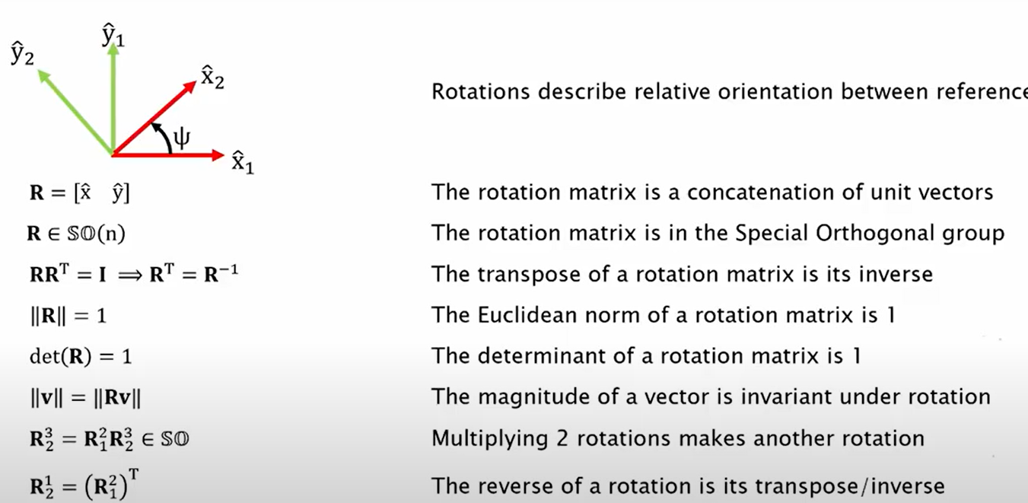
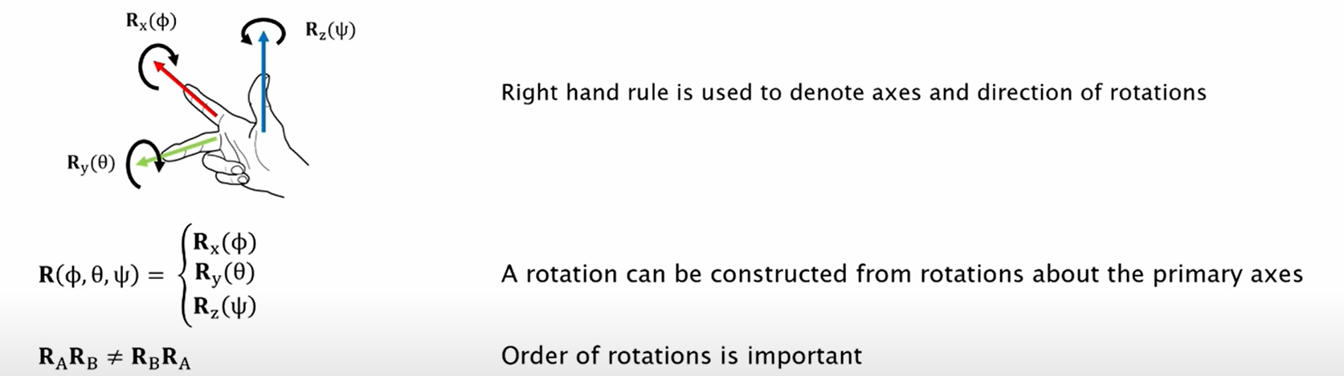
Summarizing The Concepts
Rutuja Jadhav, Department of Engineering and Applied Sciences, VIIT, Pune-48

Slide 11

Thank You
Mr.Bhausaheb Dane , Department of Engineering and Applied Sciences, VIIT, Pune-48

